Slide 1
Design and Analysis of Algorithms
Instructor: Prof. Yousef B. Mahdy

Slide 2
Course Overview
Intro to algorithm design, analysis, and applications
Algorithm Analysis
  Asymptotic Notation, Recurrence Relations, Probability & Combinatorics, Proof Techniques, Inherent Complexity.
Data Structures
  Lists, Heaps, Graphs, Trees, Balanced Trees, Hash Tables.
Sorting & Ordering
  Mergesort, Heapsort, Quicksort, Linear-time Sorts (bucket, counting, radix sort), Selection, Other sorting methods.
Algorithmic Design Paradigms
  Divide and Conquer, Dynamic Programming, Greedy Algorithms, Graph Algorithms, Randomized Algorithms.

Slide 3
Primary Focus
Develop thinking ability.
  problem solving skills.
  (algorithm design and application)
  formal thinking.
  (proof techniques & analysis)

Slide 4
What Will We Do?
Examine interesting problems.
Devise algorithms to solve them.
Prove these algorithms correct.
Analyze their resource usage (time, memory).
Understand data structures & core algorithms.
Learn problem-solving techniques.
See applications in real-world situations.

Slide 5
Goals
Be very familiar with a collection of core algorithms.
Be fluent in algorithm design paradigms: divide & conquer, greedy algorithms, randomization, dynamic programming, approximation methods.
Be able to analyze the correctness and runtime performance of a given algorithm.
Be familiar with the inherent complexity (lower bounds & intractability) of some problems.
Be intimately familiar with basic data structures.
Be able to apply techniques in practical problems.

Slide 6
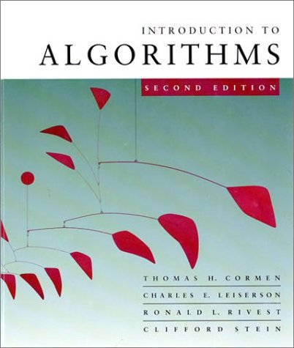
Textbook
Introduction to Algorithms, 2nd Ed. by Cormen, Leiserson, Rivest, & Stein (CLRS), McGraw Hill, 2002.

Slide 7
Course Roadmap
Algorithmic Basics
Divide and Conquer
Randomized Algorithms
Sorting and Selection
Search Trees
Graph Algorithms
Greedy Algorithms
Dynamic Programming
Special Topics

Slide 8
Algorithmic Basics
Introduction to algorithms, complexity, and proof of correctness.
Asymptotic Notation.
Goals
  Know how to write formal problem specifications.
  Know about computational models.
  Know how to measure the efficiency of an algorithm.
  Know the difference between upper and lower bounds and what they convey.
  Be able to prove algorithms correct and establish computational complexity.

Slide 9
Divide-and-Conquer
Designing Algorithms.
Recurrences.
Quicksort.
Goals
  Know when the divide-and-conquer paradigm is an appropriate one.
  Know the general structure of such algorithms.
  Express their complexity using recurrence relations.
  Determine the complexity using techniques for solving recurrences.
  Memorize the common-case solutions for recurrence relations.

Slide 10
Randomized Algorithms
Probability & Combinatorics.
Quicksort.
Hash Tables.
Goals
  Be thorough with basic probability theory and counting theory.
  Be able to apply the theory of probability to the following.
    Design and analysis of randomized algorithms and data structures.
    Average-case analysis of deterministic algorithms.
  Understand the difference between average-case and worst-case runtime, esp. in sorting and hashing.

Slide 11
Sorting & Selection
Heapsort
Quicksort
Bucket Sort, Radix Sort, etc.
Selection
Other Sorting Methods
Goals
  Know the performance characteristics of each sorting algorithm, when they can be used, and practical coding issues.
  Know the applications of binary heaps.
  Know why sorting is important.
  Know why linear-time median finding is useful.

Slide 12
Search Trees
Binary Search Trees – Not balanced
Red-Black Trees – Balanced
Goals
  Know the characteristics of the trees.
  Know the capabilities and limitations of simple binary search trees.
  Know why balancing heights is important.
  Know the fundamental ideas behind maintaining balance during insertions and deletions.
  Be able to apply these ideas to other balanced tree data structures.

Slide 13
Graph Algorithms
Basic Graph Algorithms
Goals
  Know how to represent graphs (adjacency matrix and edge-list representations).
  Know the basic techniques for graph searching.
  Be able to devise other algorithms based on graph-searching algorithms.
  Be able to “cut-and-paste” proof techniques as seen in the basic algorithms.

Slide 14
Greedy Algorithms
Greedy Algorithms
Minimum Spanning Trees
Shortest Paths
Goals
  Know when to apply greedy algorithms and their characteristics.
  Be able to prove the correctness of a greedy algorithm in solving an optimization problem.
  Understand where minimum spanning trees and shortest path computations arise in practice.

Slide 15
Dynamic Programming
Dynamic Programming
Goals
  Know when to apply dynamic programming and how it differs from divide and conquer.
  Be able to systematically move from one to the other.

Slide 16
How to Succeed in this Course
Start early on all assignments. DON'T procrastinate.
Complete all reading before class.
Participate in class.
Think in class.
Review after each class.
Be formal and precise on all problem sets and in-class exams.

Slide 17
What is an Algorithm?
(And how do we analyze one?)

Slide 18
Algorithms
Informally,
  a sequence of computational steps that transform given input to the output.
  A tool for solving a well-specified computational problem.
Example: sorting
  input: A sequence of numbers.
  output: An ordered permutation of the input.
  issues: correctness, efficiency, storage, etc.
Input
Algorithm
Output

Slide 19
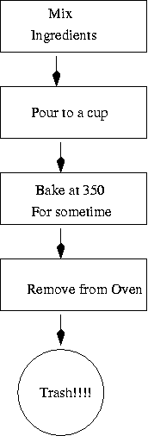
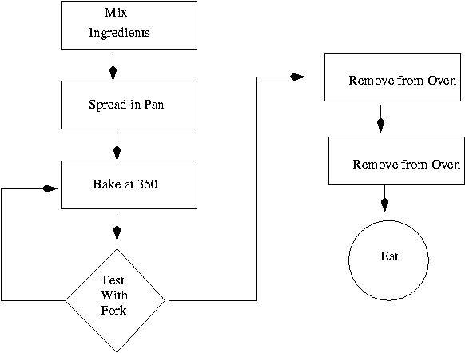

Slide 20
Algorithms
Algorithm:
Well-defined computational procedure that
takes some value(s) (called input) and produces
some value(s) (called output).
Or a sequence of computational steps that
transforms the input into the output.
Example: sorting problem.
Input: a sequence of n number <a₁, a₂, …,a_{n}>
Output: a permutation (reordering) <a₁', a₂', …,a_{n}'>
such that a₁'≤ a₂' ≤ … ≤ a_{n} '.
Problem instance: <31,41,59,26,41,58> ➔<26,31,41,41,58,59>
Correctness: an algorithm is said to be correct if for every
input instance, it halts with correct output.

Slide 21
Strengthening the Informal Definition
An algorithm is a finite sequence of unambiguous instructions for solving a well-specified computational problem.
Important Features:
  Finiteness.
  Definiteness.
  Input.
  Output.
  Effectiveness.

Slide 22
Overview
Algorithm
  A problem-solving method suitable for implementation as a computer program
Data structures
  Objects created to organize data used in computation
Data structure exist as the by-product or end product of algorithms
  Understanding data structure is essential to understanding algorithms and hence to problem-solving
  Simple algorithms can give rise to complicated data-structures
  Complicated algorithms can use simple data structures

Slide 23
Data structure: the way to store and organize data.
Techniques:
  different design and analysis techniques in this course.
  purpose is for you to design/analyze your own algorithms for new problems in the future.
Hard problem:
  Most problems discussed are efficient (poly time)
  An interesting set of hard problems: NP-complete.

Slide 24
NP-complete problem
Why interesting:
  Not known whether efficient algorithm exists for them.
  If exist for one, then exist for all.
  A small change may cause big change.
Why important:
  Arise surprisingly often in real world.
  Not waste time on trying to find efficient algorithm to get best solution, instead find approximate or near-optimal solution.
Example: traveling-salesman problem.

Slide 25
Simple example
Algorithm and data structure to do matrix arithmetic
  Need a structure to store matrix values
    Use a two dimensional array: A[M, N]
  Algorithm to find the largest element
    largest = A[0][0];
    for (i=0; i < M; i++)
    for (i=0; i < N; i++)
    if (A[i][j]>largest) then
    largest= A[i][j];
    How many times does the if statement gets executed?
    How many times does the statement “largest= A[i][j]” gets executed?

Slide 26
Algorithm – In Formal Terms…
In terms of mathematical models of computational platforms (general-purpose computers).
One definition – Turing Machine that always halts.
Other definitions are possible (e.g. Lambda Calculus.)
Mathematical basis is necessary to answer questions such as:
  Is a problem solvable? (Does an algorithm exist?)
  Complexity classes of problems. (Is an efficient algorithm possible?).

Slide 27
Analysis of algorithm
Empirical analysis
  Implement the algorithm
  Input and other factors
    Actual data
    Random data (average-case behavior)
    Perverse data (worst-case behavior)
  Run empirical tests
Mathematical analysis
  To compare different algorithms
  To predict performance in a new environment
  To set values of algorithm parameters

Slide 28
Algorithm Analysis
Determining performance characteristics. (Predicting the resource requirements.)
  Time, memory, communication bandwidth etc.
  Computation time (running time) is of primary concern.
Why analyze algorithms?
  Choose the most efficient of several possible algorithms for the same problem.
  Is the best possible running time for a problem reasonably finite for practical purposes?
  Is the algorithm optimal (best in some sense)? – Is something better possible?

Slide 29
Analysis of Algorithms
Analysis is performed with respect to a computational model
We will usually use a generic uniprocessor random-access machine (RAM)
  All memory equally expensive to access
  No concurrent operations
  All reasonable instructions take unit time
    Except, of course, function calls
  Constant word size
    Unless we are explicitly manipulating bits

Slide 30
Running Time
Run time expression should be machine-independent.
  Use a model of computation or “hypothetical” computer.
  Our choice – RAM model (most commonly-used).
Model should be
  Simple.
  Applicable.

Slide 31
RAM Model
Generic single-processor model.
Supports simple constant-time instructions found in real computers.
  Arithmetic (+, –, *, /, %, floor, ceiling).
  Data Movement (load, store, copy).
  Control (branch, subroutine call).
Run time (cost) is uniform (1 time unit) for all simple instructions.
Memory is unlimited.
Flat memory model – no hierarchy.
Access to a word of memory takes 1 time unit.
Sequential execution – no concurrent operations.

Slide 32
Model of Computation
Should be simple, or even simplistic.
  Assign uniform cost for all simple operations and memory accesses. (Not true in practice.)
  Question: Is this OK?
Should be widely applicable.
  Can’t assume the model to support complex operations. Ex: No SORT instruction.
  Size of a word of data is finite.
  Why?

Slide 33
Running Time – Definition
Call each simple instruction and access to a word of memory a “primitive operation” or “step.”
Running time of an algorithm for a given input is
  The number of steps executed by the algorithm on that input.
Often referred to as the complexity of the algorithm.

Slide 34
Complexity and Input
Complexity of an algorithm generally depends on
  Size of input.
    Input size depends on the problem.
      Examples: No. of items to be sorted.
      No. of vertices and edges in a graph.
  Other characteristics of the input data.
    Are the items already sorted?
    Are there cycles in the graph?

Slide 35
Input Size
Time and space complexity
  This is generally a function of the input size
    E.g., sorting, multiplication
  How we characterize input size depends:
    Sorting: number of input items
    Multiplication: total number of bits
    Graph algorithms: number of nodes & edges
    Etc

Slide 36
Growth of functions
Algorithms have a primary parameter N that affects the running time most significantly
  N typically represents the size of the input– e.g., file size, no. of chars in a string; etc.
Commonly encounterd running times are proportional to the following functions
  1 :Represents a constant
  Log N :Logarithmic
  N :Linear time
  N log N :Linearithmic(?)
  N ² :Quadratic
  N ³ :Cubic
  2^{N} :Exponential

Slide 37
Some common functions
lg N | N ^{0.5} | N | N lg N | N (lg N ) ² | N ² | 2^{N}
3 | 3 | 10 | 33 | 110 | 100 | 1042
7 | 10 | 100 | 664 | 444 | 10000 | 2^{10x10}= 1042¹⁰
10 | 32 | 1000 | 9966 | 99317 | 1000000 | ?
13 | 100 | 10000 | 132877 | 1765633 | 100000000 | ?
17 | 316 | 100000 | 1660964 | 27588016 | 10000000000 | ?
20 | 1000 | 1000000 | 19931569 | 397267426 | 1000000000000 | ?

Slide 38
Special functions and mathematical notations
Floor function : ⎣x⎦
  Largest integer less than or equal to x
  e.g., ⎣5.16⎦ = ?
Ceiling function: ⎡x⎤
  Smallest integer greater than or equal to x
  e.g., ⎣5.16⎦ = ?
Fibonacci: F_{N}= F_{N-1}+ F_{N-2} ; with F₀ =F₁ = 1
  Find F₂ = ? F₄ = ?
Harmonic: H_{N}= 1 + ½ + 1/3 +…+1/N
Factorial: N! = N.(N-1)!
log_{e} N = ln N; log₂ N = lg N

Slide 39
Algorithms as technology
Other modern technologies:
  Hardware with high clock rate, pipeline, ….
  Easy-to-use, GUI
  Object-oriented systems
  LAN and WAN
Algorithms are no less important than these.
Moreover, all these new technologies involve heavily algorithms.
More large and complicate problems
As a result, one characteristic separating truly skilled programmer from novices.

Slide 40
Why the course is important
Algorithms as a technology
  Suppose computers were infinitely fast and memory was free, is there any need to study algorithm?
  Need to find the easiest one to implement.
  May be very fast, but not infinitely.
  Memory may be very cheap, but not free.
  The resources (cpu time and memory) need to be used wisely, (efficient) algorithms will help.
As the basis of computer science discipline.
Core course in computer science/engineering department
(Put emphasis on practical aspects of algorithms).

Slide 41
Efficiency of Algorithms
Algorithms for solving the same problem can differ dramatically in their efficiency.
much more significant than the differences due to hardware and software.
Comparison of two sorting algorithms (n=10⁶ numbers):
  Insertion sort: c₁n²
  Merge sort: c₂n (lg n)
  Best programmer (c₁=2), machine language, one billion/second computer.
  Bad programmer (c₂=50), high-language, ten million/second computer.
  2 (10⁶)² instructions/10⁹ instructions per second = 2000 seconds.
  50 (10⁶ lg 10⁶) instructions/10⁷ instructions per second ≈ 100 seconds.
  Thus, merge sort on B is 20 times faster than insertion sort on A!
  If sorting ten million number, 2.3 days VS. 20 minutes.

Slide 42
(1.2.2) (p-13) Suppose we are comparing implementations of insertion sort and merge sort on the same machine. For inputs of size n, insertion sort runs in 8n² steps, while merge sort runs in 64n lg n steps. For which values of n does insertion sort beat merge sort? How might one rewrite the merge sort pseudocode to make it even faster on small inputs?
Insertion sort beats merge sort when:
8n² < 64n lg n,
n < 8 lg n,
2^{n/8} < n.
This is true for 2 < n < 43 (found by using a calculator).
Rewrite merge sort to use insertion sort for input of size 43 or less in order to improve the running time.

Slide 43
1.2-3 What is the smallest value of n such that an algorithm whose running time is 100n² runs faster than an algorithm whose running time is 2^{n} on the same machine?
n ≥ 15

Slide 44
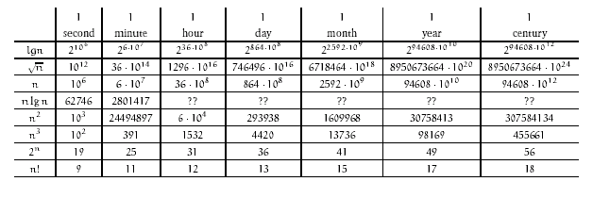
We assume that all months are 30 days and all years are 365.

Slide 45
A Puzzle -------- Let's say that you have two numbers 'a' and 'b' and you want to calculate 'ab', but you only have at your disposal the mathematical operations >>, <<, + and -; and the comparison function is_zero(). How would you do it?
result = 0
while a != 0 do
if a is even a = a / 2 b = b * 2
else
result = result + b
a = a - 1
or
result = 0
while not is_zero(a) do
a_is_even = is_zero(((a >> 1) << 1) - a)
if a_is_even a = a >> 1 b = b << 1
else
result = result + b a = a - 1
[To prove correct, look at (result + ab) before and after each iteration]

Slide 46
Chapter 2 : Getting Started

Slide 47
Insertion Sort Algorithm
Input: a sequence of n number <a₁, a₂, …,a_{n}>
Output: a permutation (reordering) <a₁', a₂', …,a_{n}'>
such that a₁'≤ a₂' ≤ … ≤ a_{n} '.
Idea: (similar to sort a hand of playing cards)
  Every time, take one card, and insert the card to correct position in already sorted cards.

Slide 48
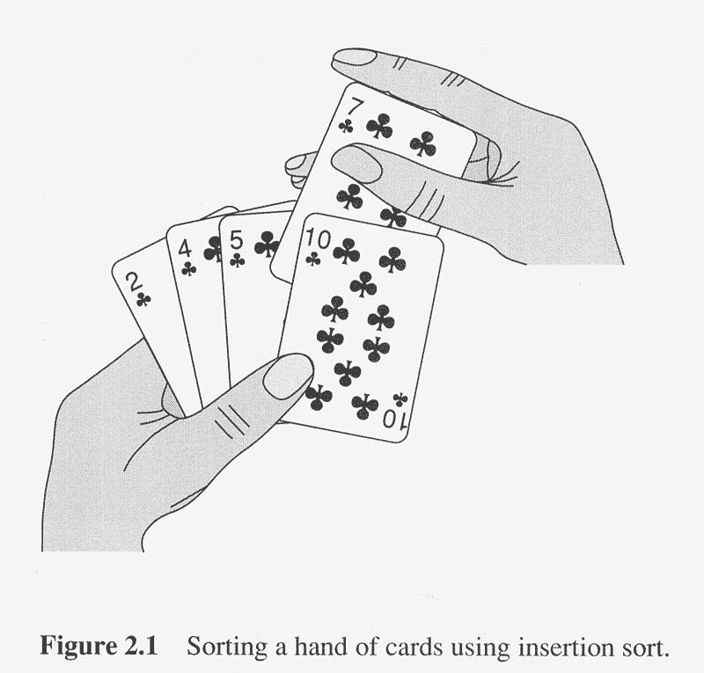
Insertion sort similar to sorting cards

Slide 49
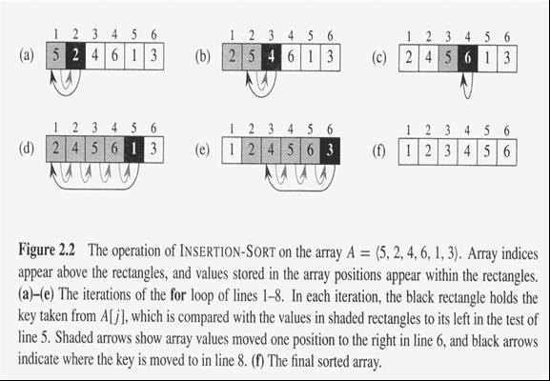

Slide 50
Insertion Sort Algorithm (cont.)
INSERTION-SORT(A)
for j = 2 to length[A]
do key ← A[j]
//insert A[j] to sorted sequence A[1..j-1]
i ← j-1
while i >0 and A[i]>key
do A[i+1] ← A[i] //move A[i] one position right
i ← i-1
A[i+1] ← key

Slide 51

Pseudocode Conventions
Indentation indicates block structure
Looping constructs have expected meanings (if, while, etc.)
Comments are denoted by 
i ← j← k is the same as j← k followed by i← j
All variables are local variables – no globals

Slide 52
Pseudocode Conventions
A[i] is the i^{th} element of array A
A[i..j] is the subarray consisting of the elements A[i], A[i+1], ... A[j-1], A[j].
Objects’ attributes use [] notation also: length[A].
Let f_{i}(x) denote the i^{th} field of object x. For any object y, if y ← x, then f_{i}(y) ← f_{i}(x), ∀i.

Slide 53
Pseudocode Conventions
Parameters are passed by value. If we have y ← x in a called procedure, local variables are created, so the results aren’t visible to the caller. Changes of values are visible, as in length[x] ← 3, which changes the length attribute “length” of x to 3.
Note: text starts indices at 1 instead of 0. An n-element array A goes from A[1] to A[n]

Slide 54
Correctness of Insertion Sort Algorithm
Loop invariant
  At the start of each iteration of the for loop, the subarray A[1..j-1] contains original A[1..j-1] but in sorted order.
Proof:
  Initialization : j=2, A[1..j-1]=A[1..1]=A[1], sorted.
  Maintenance: each iteration maintains loop invariant.
  Termination: j=n+1, so A[1..j-1]=A[1..n] in sorted order.

Slide 55
Loop Invariants
Used to show why an algorithm is correct
Must show 3 things about a loop invariant
Initialization: The loop invariant is true prior to the first iteration of the loop.
Maintenance: If LI is true before an iteration of the loop, it must remain true before the NEXT iteration.
Termination: When loop terminates, the LI gives us a useful property that helps show that the algorithm is correct.

Slide 56
Loop Invariant of Insertion Sort
At the start of each iteration of the for loop of line 1-8, the subarray A[1..j-1] consists of the elements originally in A[1..j-1] but in sorted order.
Clearly, this invariant consists of 2 parts:
A[1..j-1] consists of the elements originally in A[1..j-1]
A[1..j-1] is in sorted order
(2) alone seems to be adequate, but (1) is also true.

Slide 57
Initialization
The loop invariant is true prior to first iteration of loop.
LI must hold when j=2. Then A[1..j-1] is A[1..1] which is A[1].
A[1] is the original element in A[1].
A[1] is sorted.
1. for j ← 2 to length[A]
2. do key ← A[j]
3.  Insert A[j] into sorted sequence A[1..j-1]
4. i ← j-1
5. while i > 0 and A[i] > key
6. do A[i+1] ← A[i]
7. i ← i-1
8. A[i+1] ← key

Slide 58
Maintenance
If LI is true before an iteration of the loop, it must remain true before the NEXT iteration.
For the outer loop, note that we keep moving elements to the right until we find the correct place for A[j]. We then insert it there, so A[1..j-1] is sorted before the next iteration. Thus, the LI is maintained from iteration to iteration.
1. for j ← 2 to length[A]
2. do key ← A[j]
3.  Insert A[j] into sorted sequence A[1..j-1]
4. i ← j-1
5. while i > 0 and A[i] > key
6. do A[i+1] ← A[i]
7. i ← i-1
8. A[i+1] ← key

Slide 59
Termination
When loop terminates, the LI gives us a useful property that helps show that the algorithm is correct.
What happens at the end? Outer loop exits. j=n+1 at line 1. By substitution in LI, the subarray consists of the elements originally in A[1..n] but in sorted order. This is obviously a true statement (~property).
1. for j ← 2 to length[A]
2. do key ← A[j]
3.  Insert A[j] into sorted sequence A[1..j-1]
4. i ← j-1
5. while i > 0 and A[i] > key
6. do A[i+1] ← A[i]
7. i ← i-1
8. A[i+1] ← key

Slide 60
2:1 – 2:In line 5 of INSERTION-SORT alter A[i] > key to A[i] < key in order to sort the elements in nonincreasing order.
Algorithm 1 LINEAR-SEARCH(A; v)
Input: A = <a1; a2; : : : an> and a value v.
Output: An index i such that v = A[i] or nil if v 62 A
for i 1 to n do
if A[i] = v then
return i
end if
end for
return nil
As a loop invariant we say that none of the elements at index A[1; : : : ; i - 1] are equal to v.
Clearly, all properties are fulfilled by this loop invariant.

Slide 61
§ 2.2 Analyzing Algorithms
Predict the resources required to carry out an algorithm.
For our purposes, we shall only be concerned with execution time.
Assume instructions are executed sequentially.

Slide 62
Analyzing Algorithms
Input size: number of items in the input.
  The input size for insertion-sort for an array of n ≥ 0 is n.
Running time: the number of primitive operations or “steps” executed.

Slide 63
Assumptions about Running Time
The time required to fetch an operand from memory is constant (say t_{f})
The time required to store a result in memory is constant (say t_{s})
What is the running time of the statement y = x?
T = t_{f} + t_{s} = constant

Slide 64
Assumptions about Running Time
The times required to perform elementary arithmetic operations (+, - ...) are all constants, and given by t₊, t₋, etc...
What is the running time of the statement y = y + 1?
Requires one fetches, one addition, and one store.
T = t_{f} + t_{s} + t₊ = constant

Slide 65
Assumptions about Running Time
The time required to call a method is a constant t_{call}, and the time required to return from a method is a constant t_{return}
The time required to pass an argument to a method is the same as the time required to store a value in memory: t_{s}
What is the running time of y = f(x)?
T = t_{f} + 2t_{s} + t_{call} + T_{f(x)}
Since we pass x to f(), this counts as one t_{s}. We don’t know the running time of f(x) above, so we don’t know if T=constant.

Slide 66
Running Time
So, the following can be assumed throughout the text:
Assume a constant amount of time is required to execute each line of our pseudocode.
Assume that each execution of the i^{th} line takes time c_{i}, where c_{i} is a constant. c_{i} is known as the “cost” to execute the statement at line i.
Clearly, since each statement has different operations, each statement can have a different running time c_{i}.

Slide 67
Total Running Time T(n)
Used to evaluate an algorithm.
Independent of the machine
Depends only on the time required to execute all of the statements in the algorithm, based on the previous assumptions.

Slide 68
Looping Example
Consider the statement
for( int i = 0; i < n; i++)
We assume declarations are constant time t_{dec}.
1a. int i = 0 t_{dec} + t_{f} + t_{s} = constant = c_{a}
1b. i < n (t< + 2t_{f} )[(n-0) + 1 ) = c_{b}(n+1)
1c. i++ (2t_{f} + t+ + t_{s} )n= c_{c}
Total time for loop: c_{a} + c_{b}(n+1) + c_{c}n = c_{d}n + c_{e}
Note that the test is executed once more do to the initial test at the beginning. Recall that after the increment, the test condition is always executed.

Slide 69
Summations
Some basic formulii
Σ_{j=1,n} (ca_{j} + b_{j}) = Σ_{j=1,n} ca_{j} + Σ_{j=1,n} b_{j}
= cΣ_{j=1,n} a_{j} + Σ_{j=1,n} b_{j}
Σ_{j=1,n} j = 1 + 2 + ... n = (1+n) + [2+(n-1)] ...
= (n/2) (n+1) = O(n²)
Σ_{j=1,n} k² = ???.
Let’s derive this formula by using the property called “telescoping”

Slide 70
Telescoping
Σ_{j=1,n} (a_{j} – a_{j-1}) = (a₁ – a₀) + (a₂ – a₁) + (a₃ – a₂) + ... + (a_{n} – a_{n-1})
rearranging...
Σ_{j=1,n} (a_{j} – a_{j-1}) = -a₀ +a₁ – a₁ + a₂ – a₂ + a₃ – a₃ +... + a_{n-1} – a_{n-1} + a_{n}
= a_{n} – a₀
Now derive a simpler formula for Σ_{j=1,n} k² using the “trick” that
(k+1)³ – k³ = 3k² + 3k + 1
Σ_{j=1,n} [(k+1)³ – k³] = Σ_{j=1,n} ( 3k² + 3k + 1)
Because of telescoping, lhs reduces to –1 + (n+1)³, so we have
-1 + (n+1)3 = 3 Σ_{j=1,n} j² + 3 Σ_{j=1,n} j + Σ_{j=1,n} 1
Since Σ_{j=1,n} j = (n/2)(n+1), and Σ_{j=1,n} 1 = n, just solve for Σ_{j=1,n} j²

Slide 71
Telescoping, ctd
Σ_{j=1,n} j² = n(n+1)(2n+1)/6
Using
(k+1)⁴ – k⁴ = 5k³ + 10k² + 5k + 1
you can derive the identity
Σ_{j=1,n} j³ = n²(n+1)²/4

Slide 72
Simple Example Using PseudoCode
Initialize an array A | cost | times
1. for i ← 1 to length[A] | c₁ | n+1
2. A[i] ← i | c₂ | n
Total running time = (n+1) • c₁ + n • c₂ T(n) = (c₁ + c₂) n + c₁
Why does times = n+1 for line 1?

Slide 73
Worst, Average, and Best-case Complexity
Worst-case Complexity
  Maximum steps the algorithm takes for any possible input.
  Most tractable measure.
Average-case Complexity
  Average of the running times of all possible inputs.
  Demands a definition of probability of each input, which is usually difficult to provide and to analyze.
Best-case Complexity
  Minimum number of steps for any possible input.
  Not a useful measure. Why?

Slide 74

A Simple Example – Linear Search
INPUT: a sequence of n numbers, key to search for.
OUTPUT: true if key occurs in the sequence, false otherwise.
LinearSearch(A, key) cost times
1 i ← 1 c₁ 1
2 while i ≤ n and A[i] != key c₂ x
3 do i++ c₃ x-1
if i ≤ n c₄ 1
then return true c₅ 1
else return false c₆ 1
x ranges between 1 and n+1.
So, the running time ranges between
c₁+ c₂+ c₄ + c₅ – best case
and
c₁+ c₂(n+1)+ c₃n + c₄ + c₆ – worst case

Slide 75
A Simple Example – Linear Search
INPUT: a sequence of n numbers, key to search for.
OUTPUT: true if key occurs in the sequence, false otherwise.
LinearSearch(A, key) cost times
1 i ← 1 1 1
2 while i ≤ n and A[i] != key 1 x
3 do i++ 1 x-1
if i ≤ n 1 1
then return true 1 1
else return false 1 1
Assign a cost of 1 to all statement executions.
Now, the running time ranges between
1+ 1+ 1 + 1 = 4 – best case
and
1+ (n+1)+ n + 1 + 1 = 2n+4 – worst case

Slide 76
A Simple Example – Linear Search
INPUT: a sequence of n numbers, key to search for.
OUTPUT: true if key occurs in the sequence, false otherwise.
LinearSearch(A, key) cost times
1 i ← 1 1 1
2 while i ≤ n and A[i] != key 1 x
3 do i++ 1 x-1
if i ≤ n 1 1
then return true 1 1
else return false 1 1
If we assume that we search for a random item in the list, on an average, Statements 2 and 3 will be executed n/2 times. Running times of other statements are independent of input.
Hence, average-case complexity is
1+ n/2+ n/2 + 1 + 1 = n+3

Slide 77
Insertion-Sort Algorithm (again)
Insertion-Sort(A)
1. for j ← 2 to length[A]
2. do key ← A[j]
3.  Insert A[j] into sorted sequence A[1..j-1]
4. i ← j-1
5. while i > 0 and A[i] > key
6. do A[i+1] ← A[i]
7. i ← i-1
8. A[i+1] ← key

Slide 78
Insertion-Sort Running Time
T(n) =
c₁ • [(n-1)+1]
+ c₂ • (n-1) + c₃ • (n-1) + c₄ • (n-1)
+ c₅ • (Σ_{j=2,n} t_{j})
+ c₆ • ( Σ_{j=2,n} (t_{j} -1) )
+ c₇ • ( Σ_{j=2,n} (t_{j} -1) )
+ c₈ • (n-1)
c₃ = 0, of course, since it’s the comment

Slide 79
Worst Case T(n)
Occurs when the loop of lines 5-7 is executed as many times as possible, which is when A[] is in reverse sorted order.
key is A[j] from line 2
i starts at j-1 from line 4
i goes down to 0 due to line 7
So, t_{j} in lines 5-7 is [(j-1) – 0] + 1 = j
The ‘1’ at the end is due to the test that fails, causing exit from the loop.

Slide 80
Worst Case T(n), ctd.
T(n) = c₁ • [(n-1)+1]
+ c₂ • (n-1) + c₄ • (n-1)
+ c₅ • (Σ_{j=2,n} j)
+ c₆ • [ Σ_{j=2,n} (j -1) ]
+ c₇ • [ Σ_{j=2,n} (j -1) ]
+ c₈ • (n-1)

Slide 81
Worst Case T(n), ctd.
T(n) =
c₁ • n + c₂ • (n-1) + c₄ • (n-1) + c₈ • (n-1)
+ c₅ • (Σ_{j=2,n} j)
+ c₆ • [ Σ_{j=2,n} (j -1) ] + c₇ • [ Σ_{j=2,n} (j -1) ]
= c₉ • n + c₁₀ + c₅ • (Σ_{j=2,n} j) + c₁₁ • [ Σ_{j=2,n} (j -1) ]

Slide 82
Worst Case T(n), ctd.
T(n) =
c₉ • n + c₁₀ + c₅ • (Σ_{j=2,n} j) + c₁₁ • [ Σ_{j=2,n} (j -1) ]
But
Σ_{j=2,n} j = [n(n+1)/2] – 1
so that
Σ_{j=2,n} (j-1) = Σ_{j=2,n} j – Σ_{j=2,n} (1)
= [n(n+1)/2] – 1 – (n-2+1)
= [n(n+1)/2] – 1 – n + 1 = n(n+1)/2 - n
= [n(n+1)-2n]/2 = [n(n+1-2)]/2 = n(n-1)/2
Wasn’t that fun?

Slide 83
Worst Case T(n), ctd.
In conclusion,
T(n) =
c₉ • n + c₁₀ + c₅ • [n(n+1)/2] – 1 + c₁₁ • n(n-1)/2
= c₁₂ • n² + c₁₃ • n + c₁₄
= f₁(n²) + f₂(n¹) + f₃(n⁰)

Slide 84
Best Case
If already sorted, statements in while loop never execute since A[i] <= key, ∀i ∈ [1, i-1] on line 5. So, line 5 is executed only once, and we never enter the while loop:
T(n) = c₁ • [(n-1)+1] + c₂ • (n-1) + c₄ • (Σ_{j=1,n} t_{j})
+ c₃ • ( Σ_{j=1,n} (t_{j} -1) )
becomes
T(n) = c₁ • (n+1) + c₂ • (n) + c₃ • (n-1)
= (c₁ + c₂ + c₃) • n + (c₁ – c₃)

Slide 85
Best Case Result
T(n) =
c₁ • n + (c₂ + c₄) • (n-1) + c₅ • (n-1)
+ c₈ • (n-1)
= n • ( c₁ + c₂ + c₄ + c₅ + c₈ )
+ ( -c₂ – c₄ - c₅ – c₈ )
= c₉n + c₁₀
= f₁(n¹) + f₂(n⁰)

Slide 86
Order of growth
Principal interest is to determine
  how running time grows with input size – Order of growth.
  the running time for large inputs – Asymptotic complexity.
In determining the above,
  Lower-order terms and coefficient of the highest-order term are insignificant.
  Ex: In 7n⁵+6n³+n+10, which term dominates the running time for very large n?
Complexity of an algorithm is denoted by the highest-order term in the expression for running time.
  Ex: Ο(n), Θ(1), Ω(n²), etc.
  Constant complexity when running time is independent of the input size – denoted Ο(1).
  Linear Search: Best case Θ(1), Worst and Average cases: Θ(n).

Slide 87
Comparison of Algorithms
Complexity function can be used to compare the performance of algorithms.
Algorithm A is more efficient than Algorithm B for solving a problem, if the complexity function of A is of lower order than that of B.
Examples:
  Linear Search – Θ(n) vs. Binary Search – Θ(lg n)
  Insertion Sort – Θ(n²) vs. Quick Sort – Θ(n lg n)

Slide 88
Comparisons of Algorithms
Multiplication
  classical technique: O(nm)
  divide-and-conquer: O(nm^{ln1.5}) ~ O(nm^{0.59})
  For operands of size 1000, takes 40 & 15 seconds respectively on a Cyber 835.
Sorting
  insertion sort: Θ(n²)
  merge sort: Θ(n lg n)
  For 10⁶ numbers, it took 5.56 hrs on a supercomputer using machine language and 16.67 min on a PC using C/C++.

Slide 89
Why Order of Growth Matters?
Computer speeds double every two years, so why worry about algorithm speed?
When speed doubles, what happens to the amount of work you can do?
What about the demands of applications?

Slide 90
Effect of Faster Machines
No. of items sorted
Ο(n²)
H/W Speed
1 M*
2 M
Gain
Comp. of Alg.
1000
1414
1.414
  O(n lgn)
62700
118600
1.9
* Million operations per second.
Higher gain with faster hardware for more efficient algorithm.
Results are more dramatic for more higher speeds.

Slide 91
Correctness Proofs
Proving (beyond “any” doubt) that an algorithm is correct.
  Prove that the algorithm produces correct output when it terminates. Partial Correctness.
  Prove that the algorithm will necessarily terminate. Total Correctness.
Techniques
  Proof by Construction.
  Proof by Induction.
  Proof by Contradiction.

Slide 92
Loop Invariant
Logical expression with the following properties.
  Holds true before the first iteration of the loop – Initialization.
  If it is true before an iteration of the loop, it remains true before the next iteration – Maintenance.
  When the loop terminates, the invariant ― along with the fact that the loop terminated ― gives a useful property that helps show that the loop is correct – Termination.
Similar to mathematical induction.
  Are there differences?

Slide 93
Correctness Proof of Linear Search
Use Loop Invariant for the while loop:
  At the start of each iteration of the while loop, the search key is not in the subarray A[1..i-1].
LinearSearch(A, key)
1 i ← 1
2 while i ≤ n and A[i] != key
3 do i++
if i ≤ n
then return true
else return false
If the algm. terminates, then it produces correct result.
  Initialization.
  Maintenance.
  Termination.
Argue that it terminates.

Slide 94
Go through correctness proof of insertion sort in the text.

